Slide 1
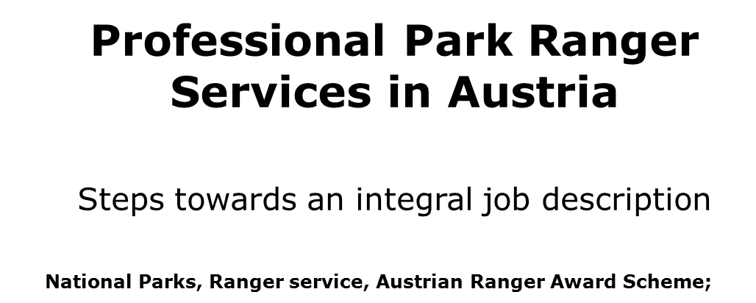

Slide 2
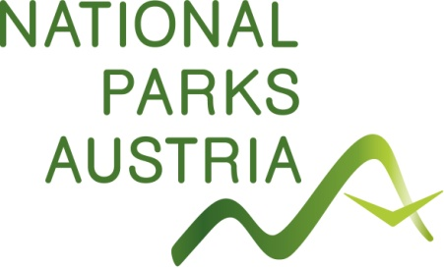

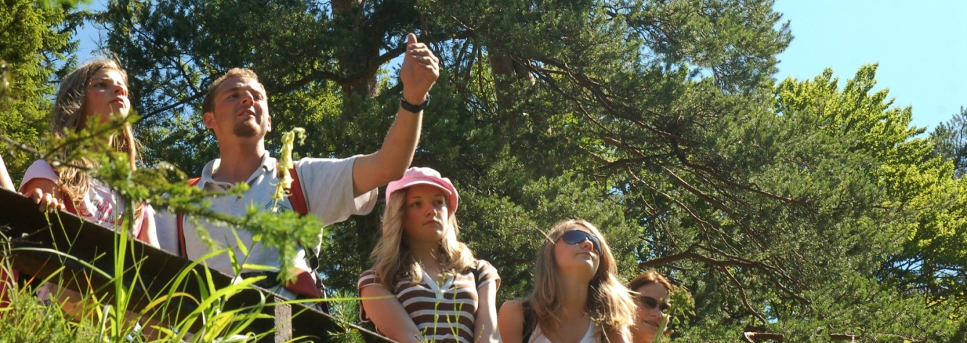

“From surveillance to education on the territory”
Background information
Thousands of people visit Austrians National Parks each day. National Park Ranger are usually the first and often the only representatives of the Park to come into direct contact with visitors. As such they are the “human face” of the Protected Area. Well-organised services of skilled and motivated Rangers are the best guarantee for both adequate protection of nature and satisfied, well-informed visitors.
Professional Park Ranger Services in Austria. February, 18th Vanoise NP; Martin Hartmann

Slide 3


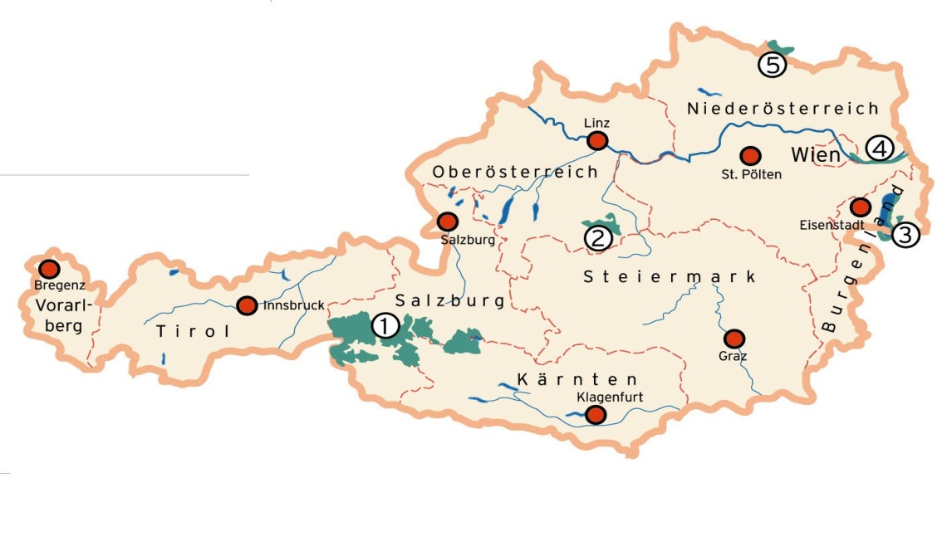




There were different conditions Austrian Park Rangers have to deal with. Six National Parks had six different internal education programmes for their own staff, varying in time, contents and qualification.
Otherwise the tasks and duties of Rangers just as their competencies are total diverse in the particular National Parks.
□

Slide 4
Previous efforts…
Nationwide:
Status quo of the education of Nationalpark Ranger in Austria, 1997
Meeting “New Jobs In Nature”, 1999
Minimum standards for Rangers, 2000
Efforts to establish a certificate course “Certified Nationalpark Ranger”, 2001
Minimum standards for Rangers, 2005
International:
European Ranger Project, 2000
TOPAS – Training of Protected Area Staff, 2004

Slide 5
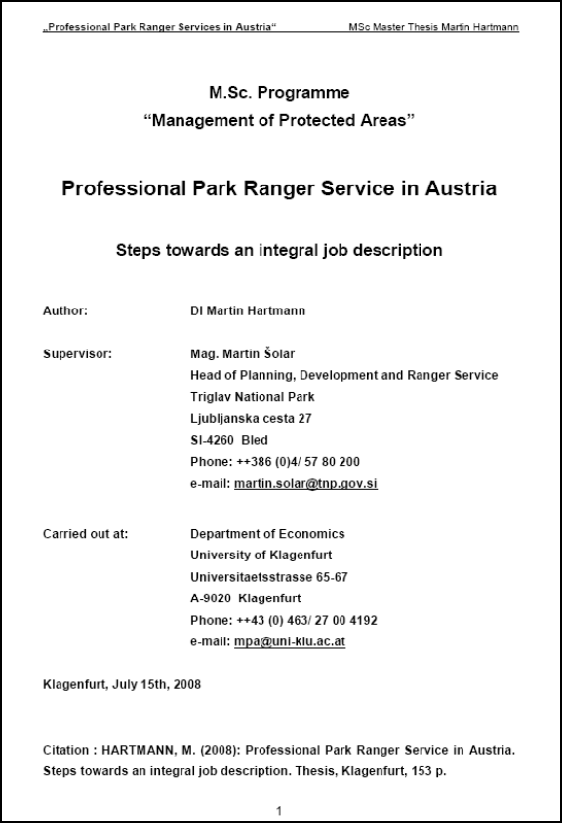

Slide 6
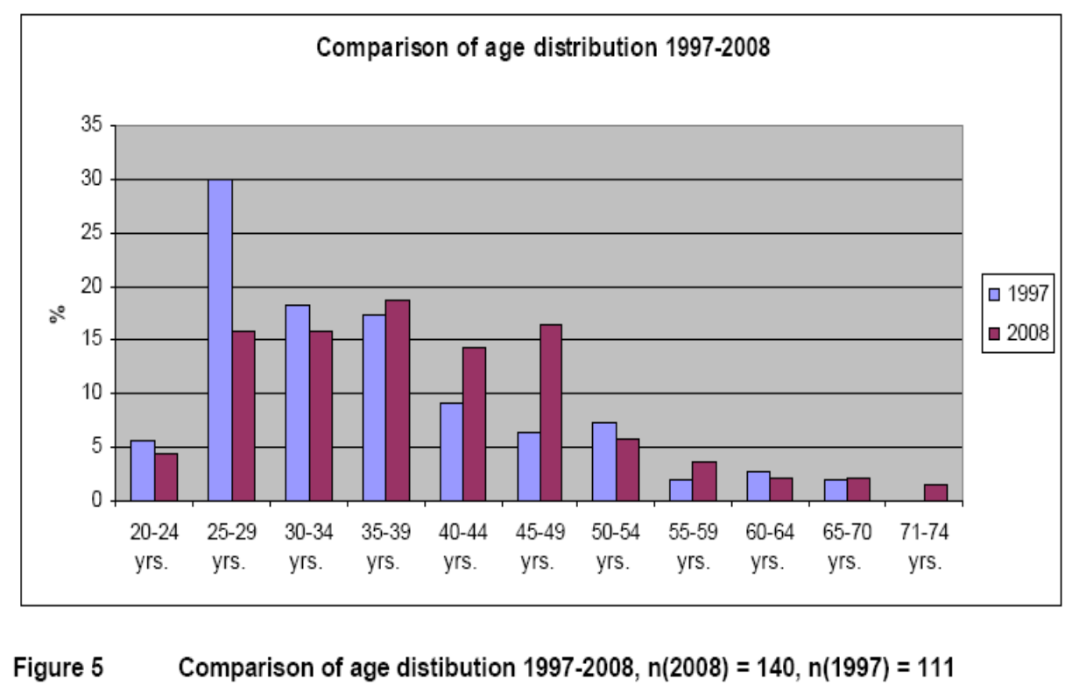

Slide 7
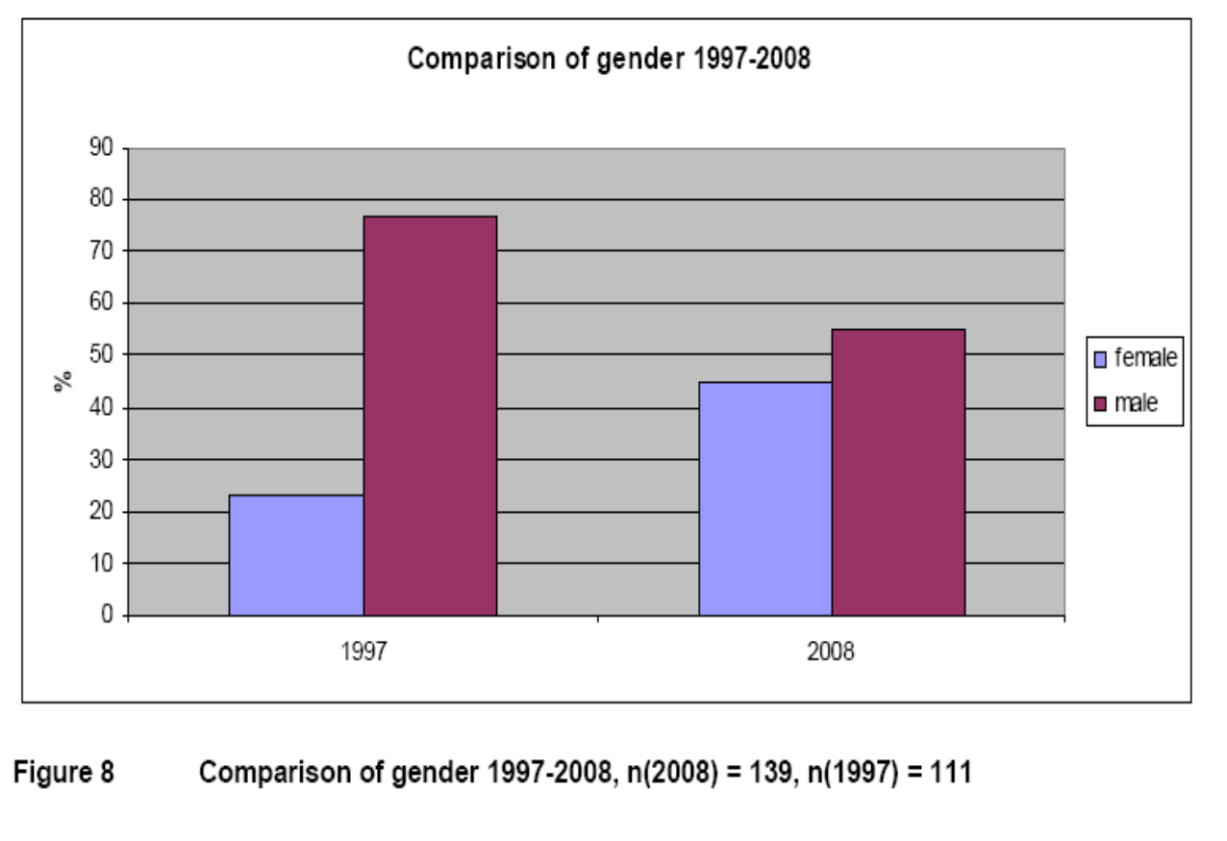

Slide 8
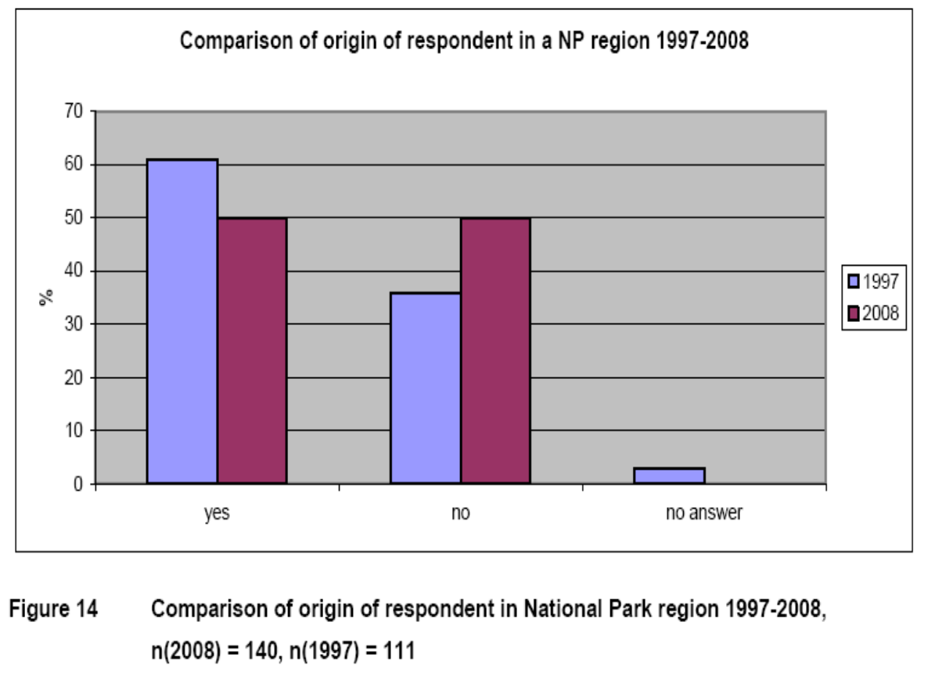

Slide 9
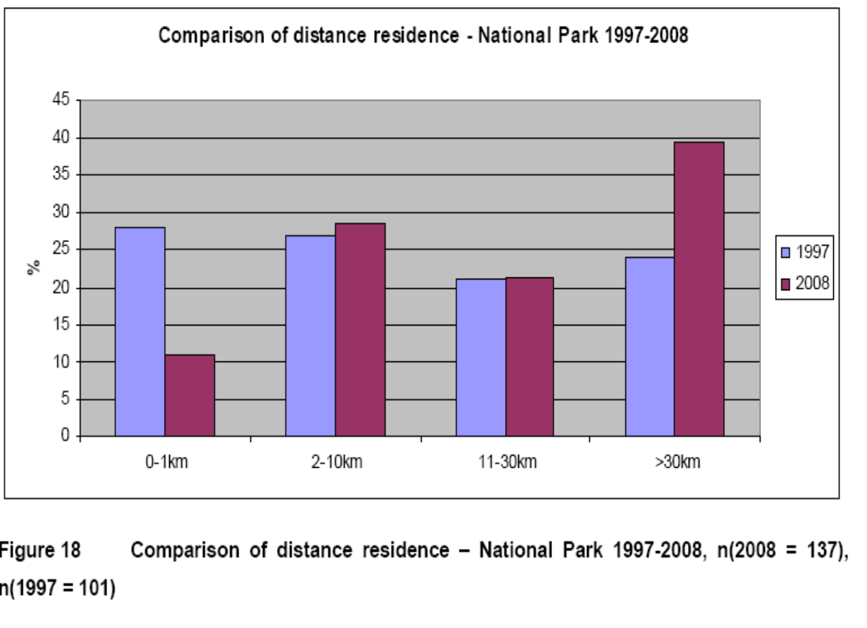

Slide 10
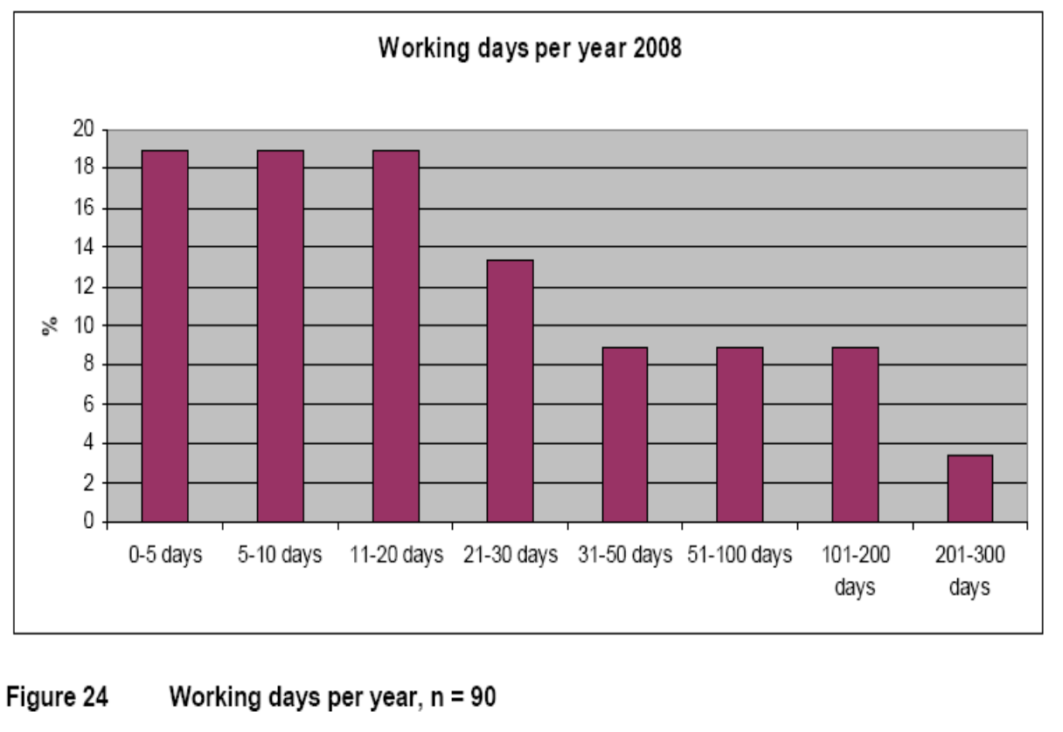

Slide 11
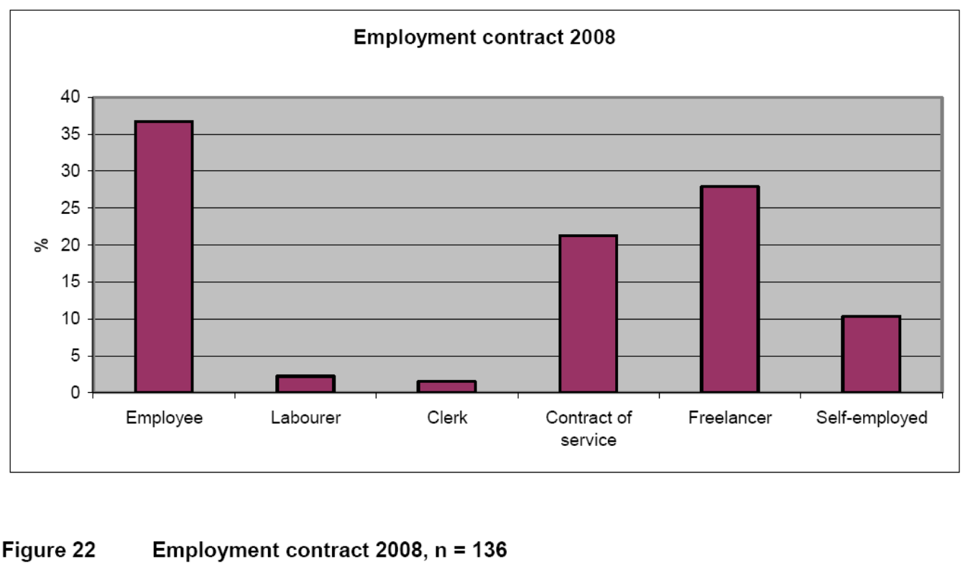

Slide 12
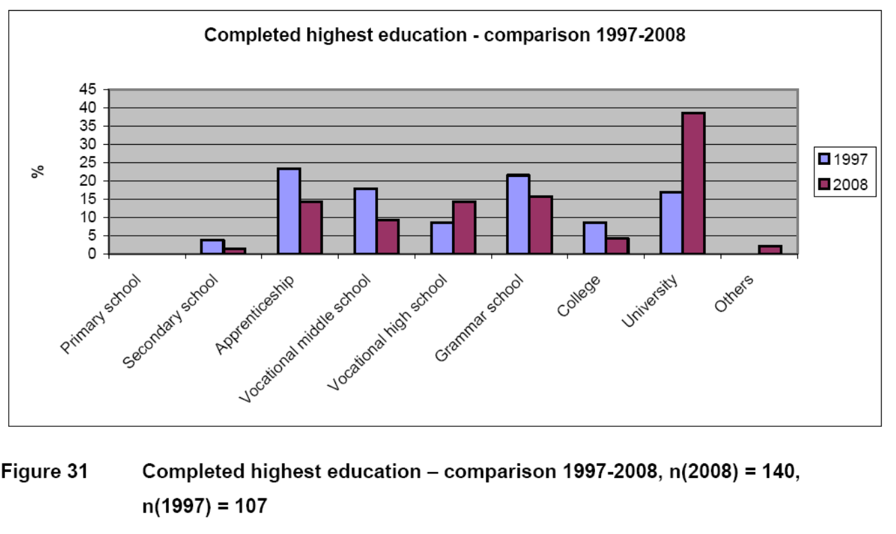

Slide 13
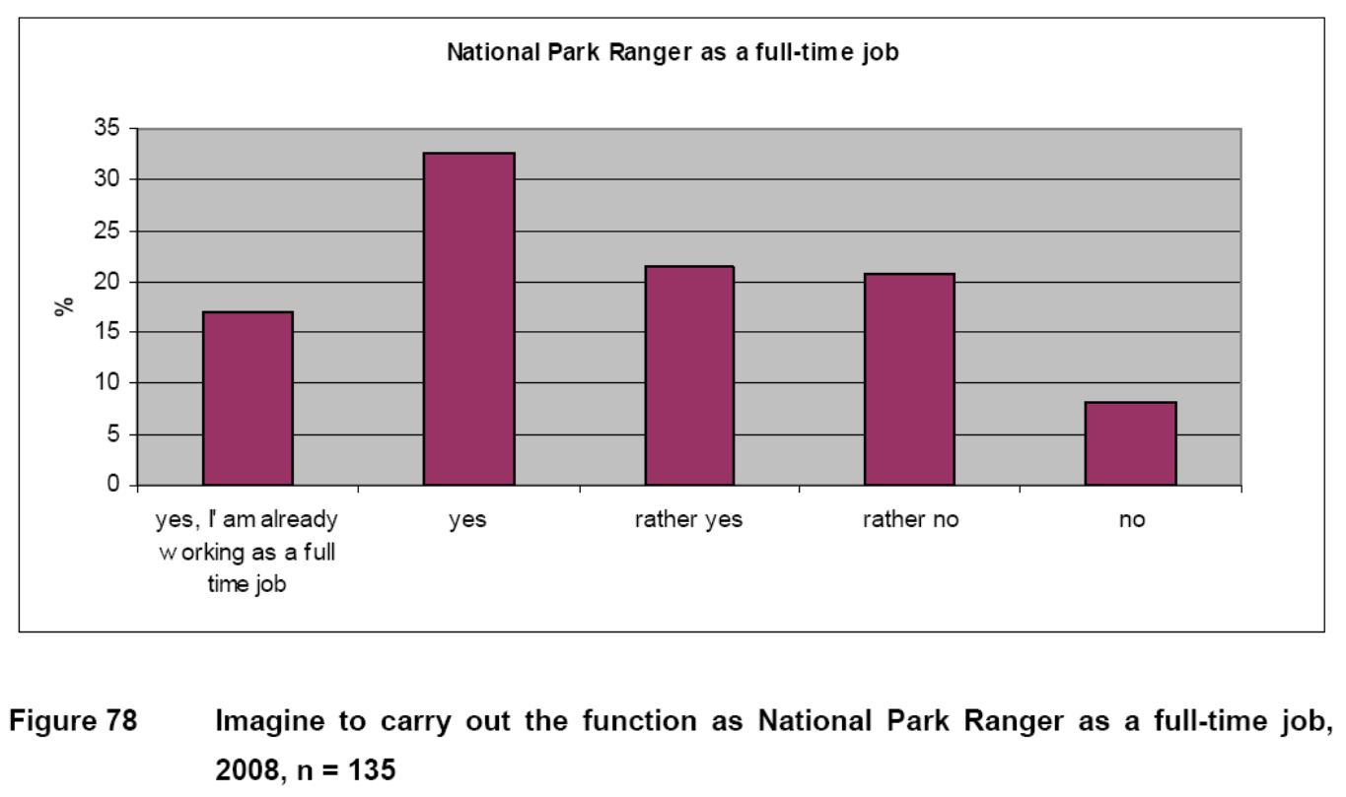

Slide 14
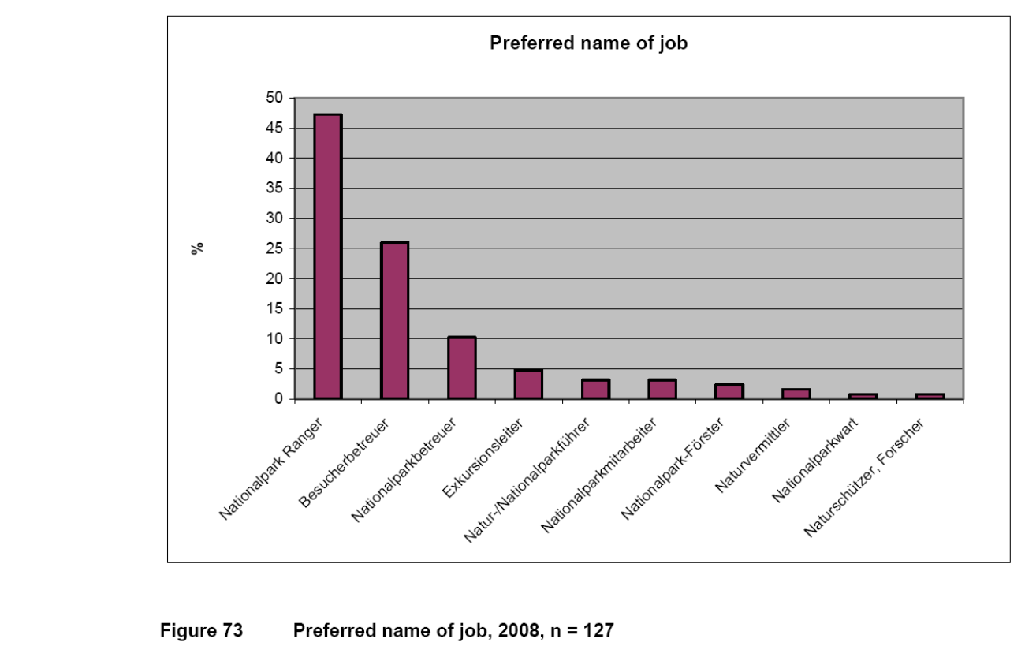

Slide 15
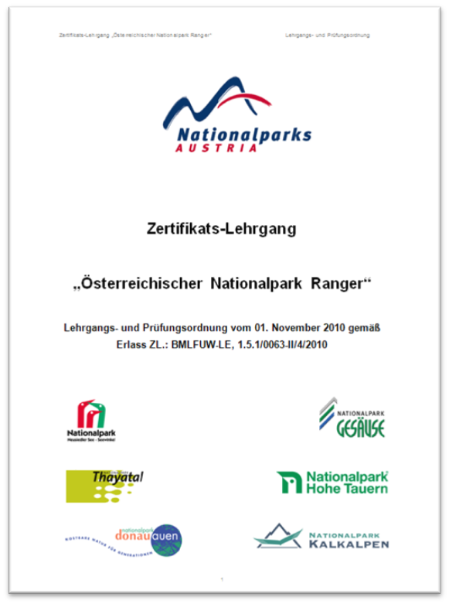
Advantages of an integral job description „Nationalpark Ranger“
Clearly and integrative designation (identity and image) – not only for Nationalparks useful (NATURA 2000, etc.)
Definition and clarification of the legal framework
Quality assurance by an equal Ranger training course
A better image about locals, visitors and environmental policy
Well-defined limit against similar professions
Allocation of furtherance
Nationwide and international exchange

Slide 16
A „Certified Austrian Nationalpark Ranger“ should have:
... excellent pedagogical and didactical skills, including a variety of techniques to connect messages, knowledge and values (wildlife watching, guided tours, role plays, global environmental education, sustainability etc.).
... enough knowledge about the special ecological features of the relevant National Park or protected area, about the dynamic of the regional landscape and their biodiversity, to understand the regional culture as well as resulting conflicts of landuse and management.

Slide 17
A) Certificate course „Ground Module“
„Dieser Lehrgang beinhaltet den allgemeinen, für alle Österreichischen Nationalparks gültigen Teil und umfasst insgesamt 17 Ausbildungstage.“
B) Certificate course „Advanced module“
„Dieser Lehrgang stellt den spezifischen, auf einen einzelnen Nationalpark angepassten Teil dar und besteht aus insgesamt 25 Ausbildungstagen, davon 10 Praxistagen, im jeweiligen Schutzgebiet.“
C) Advanced training courses
„Die Nationalpark-Verwaltungen bieten für zertifizierte Nationalpark Ranger regelmäßig ein- bis mehrtägige Fortbildungsveranstaltungen an.“

Slide 18
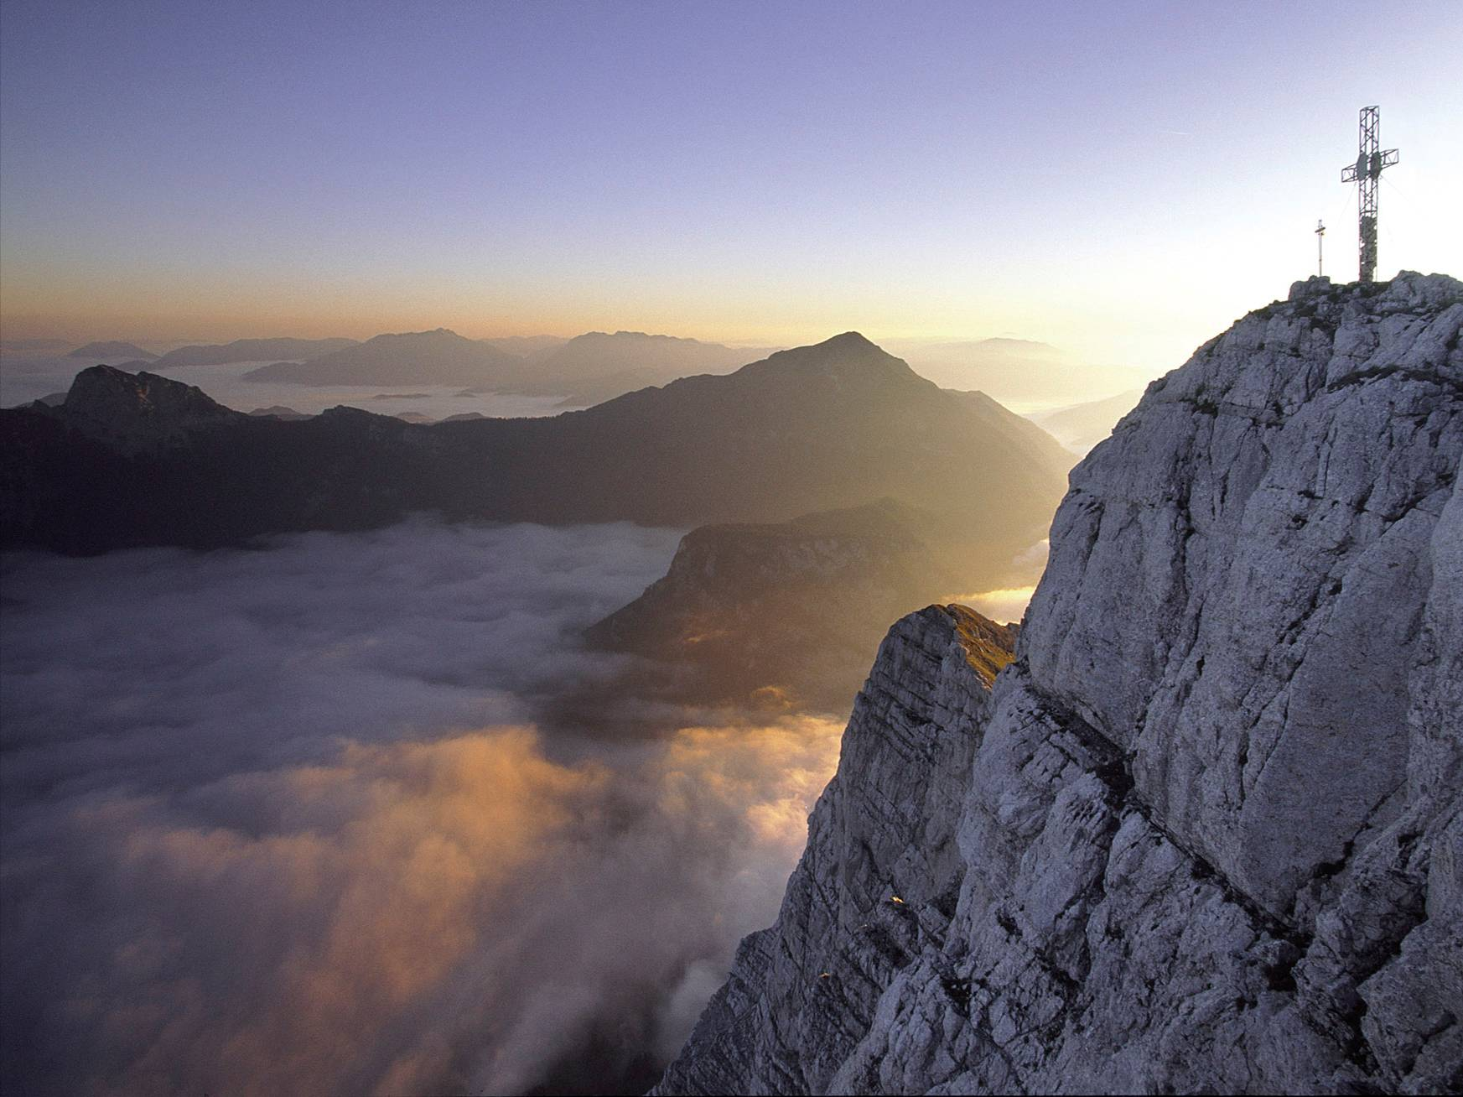

Slide 19
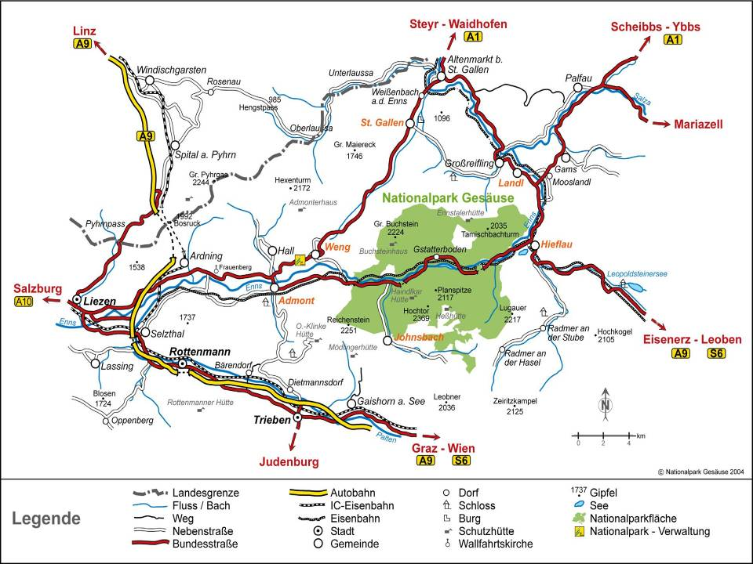

Slide 20
Recreational activities
Hiking
4 alpine huts with 6000-7000 overnight stays/ year
> 100km of hiking trails
Climbing
> 2000 climbing routes
Mountainbiking
3 mountainbike trails
Rafting & Canyoning
Enns, Bruckgraben
River recreation
3 visitor areas
Backcountry skiing/ ski mountaineering & snowshoe hiking
number increasing (see graph)
Participants of programmes of the National Park (school classes, visitors of excursions in summer and winter)
number of visitors increases year by year

Slide 21
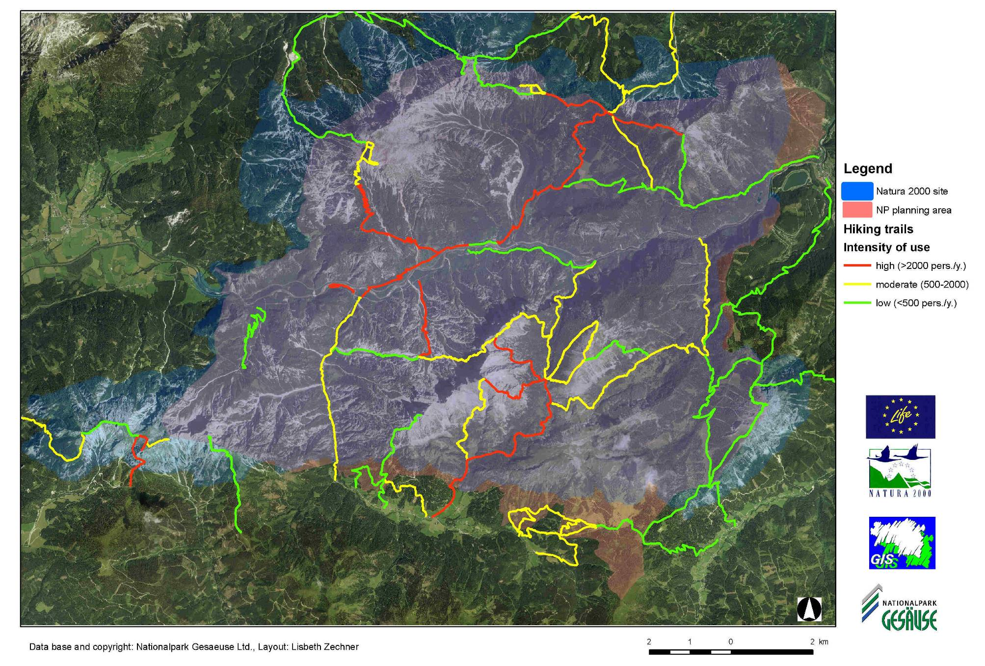

Slide 22
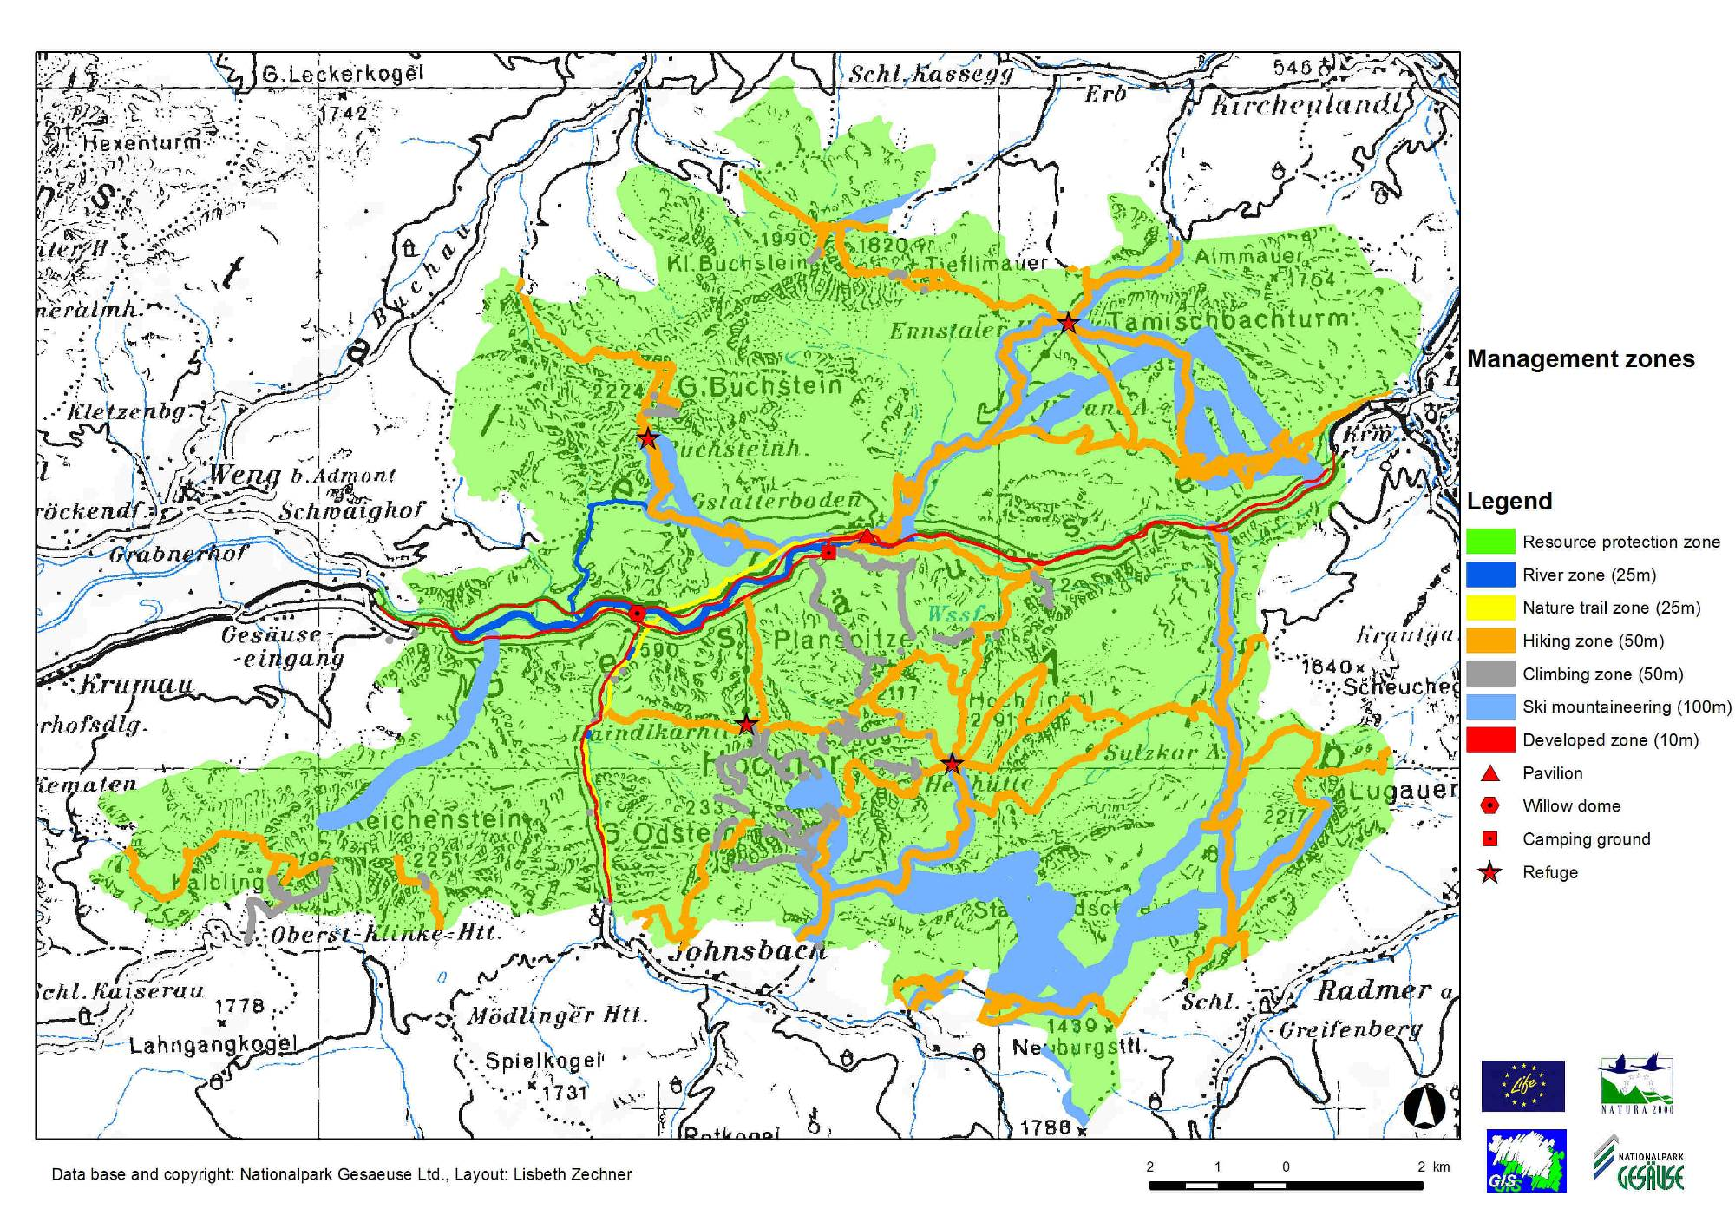

Slide 23
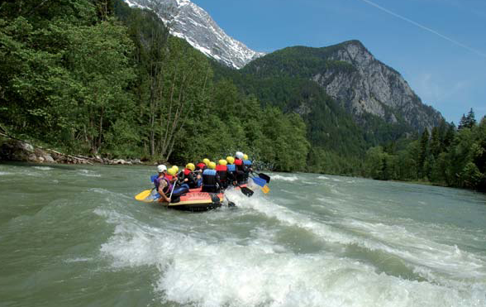
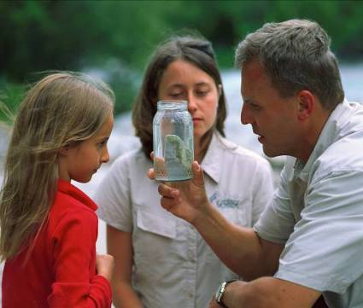
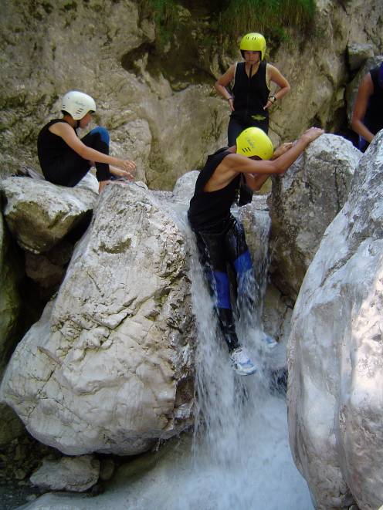
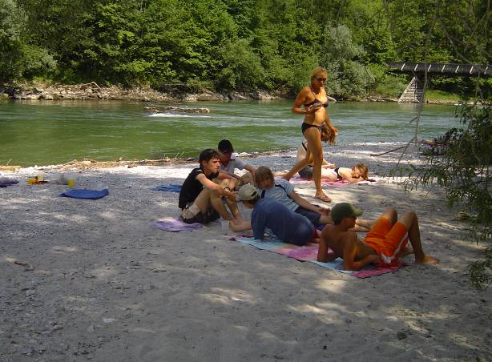
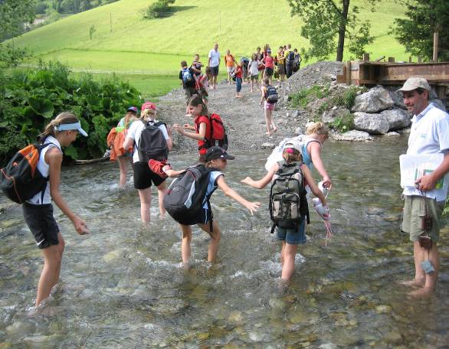
River recreation

Slide 24
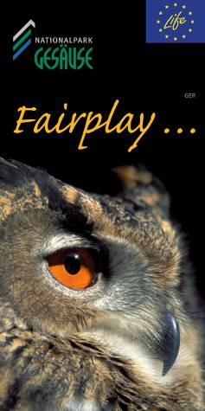
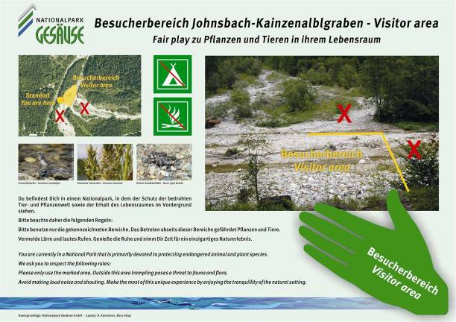
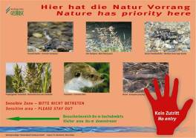
Signs on-site

Slide 25
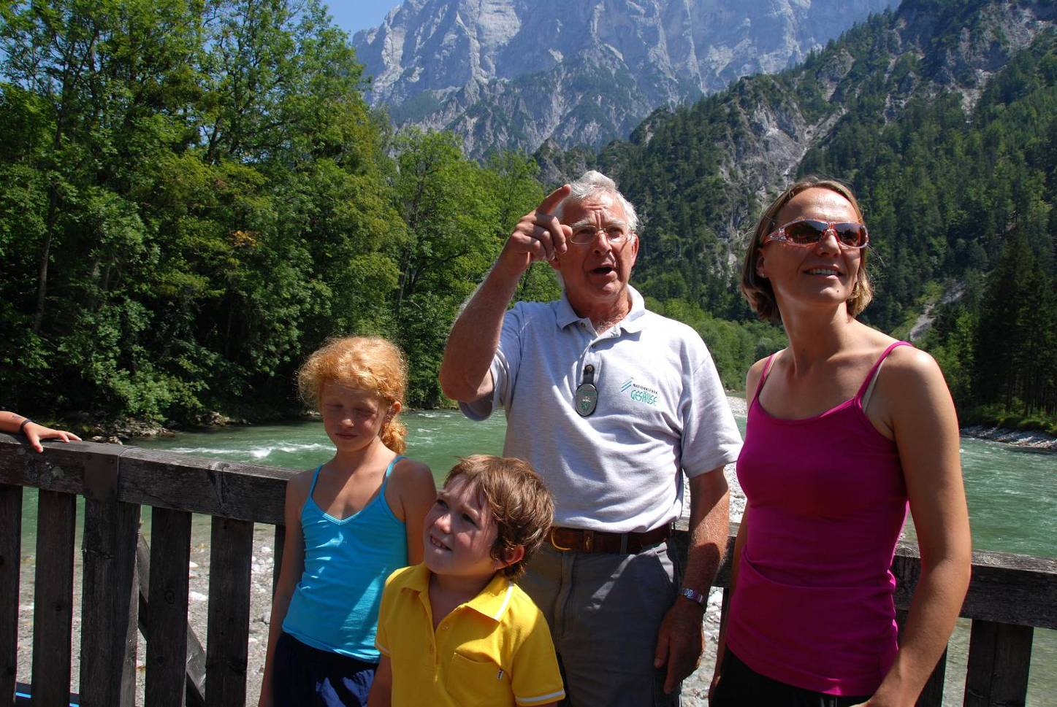
On-site National Park Rangers

Slide 26
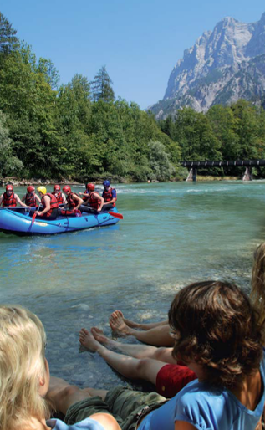
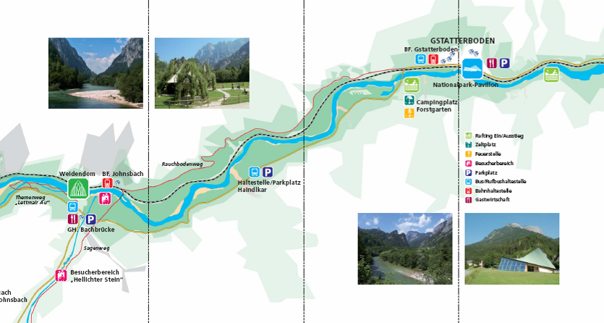
Brochure on river recreation

Slide 27
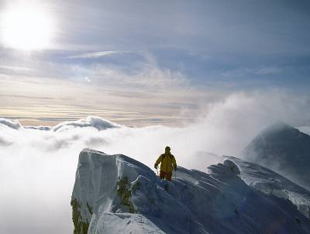
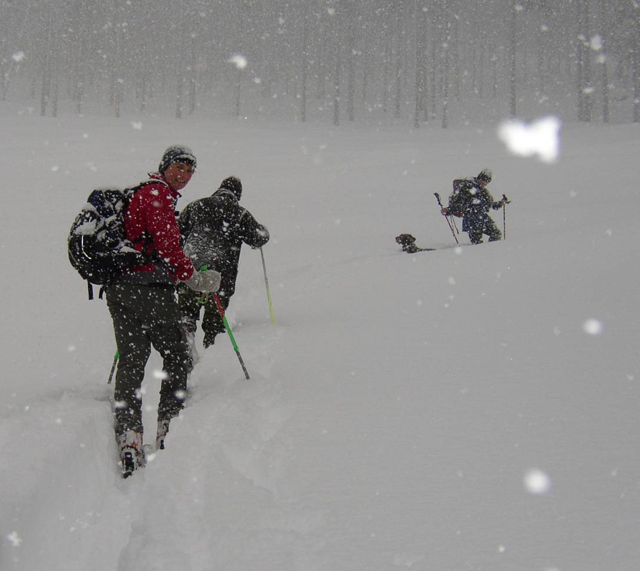
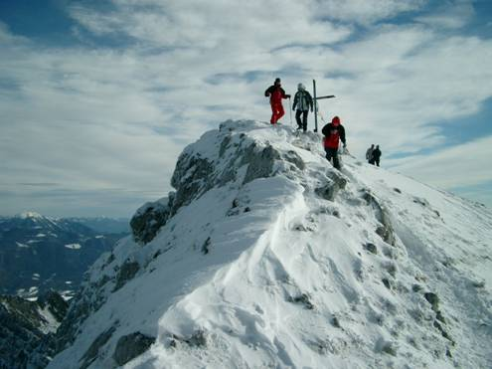
Backcountry skiing

Slide 28
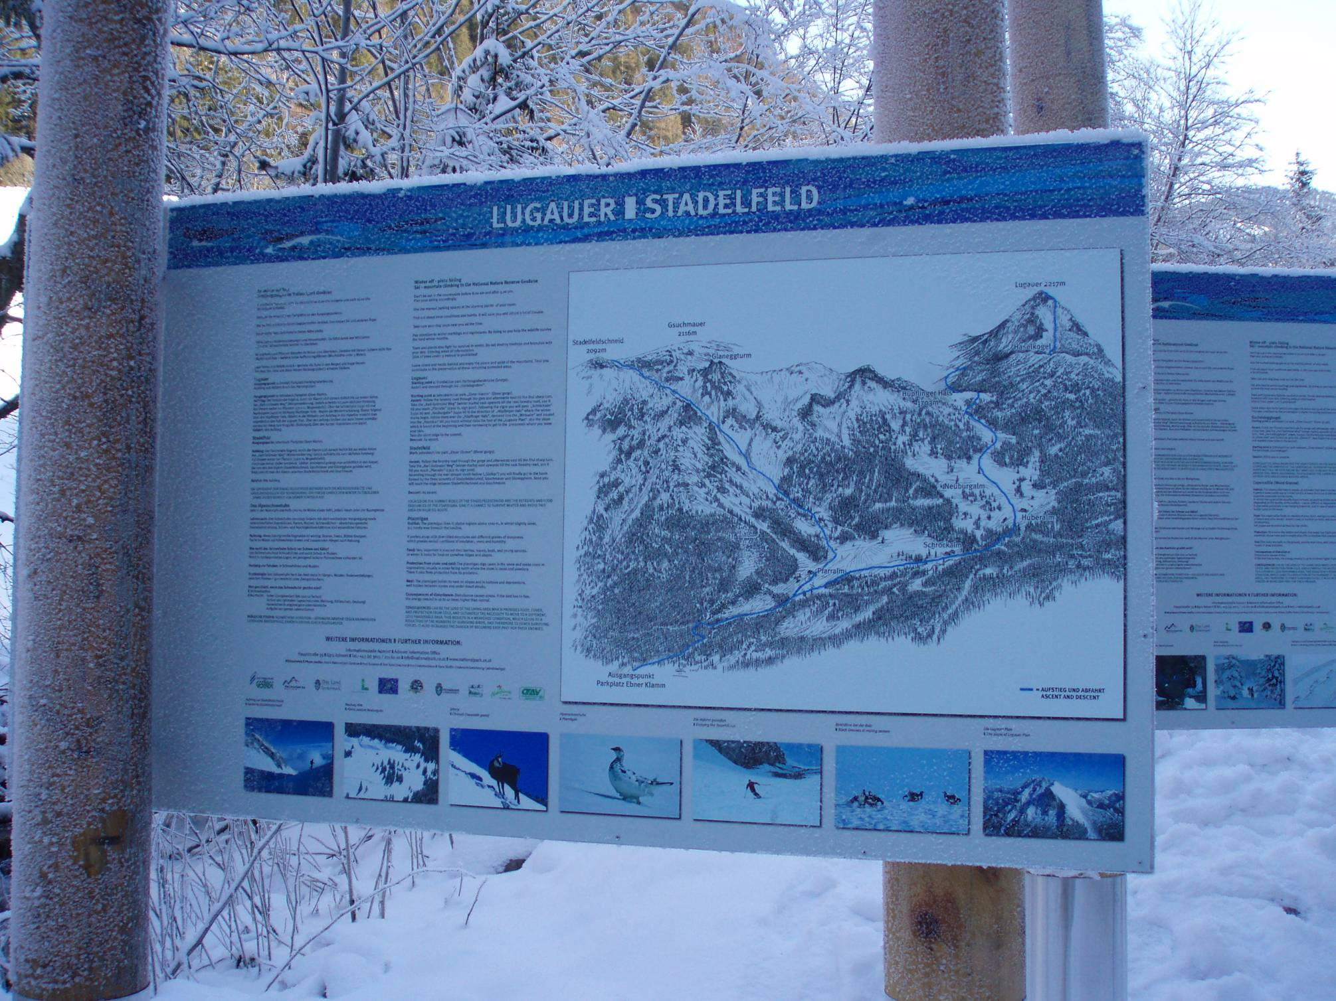
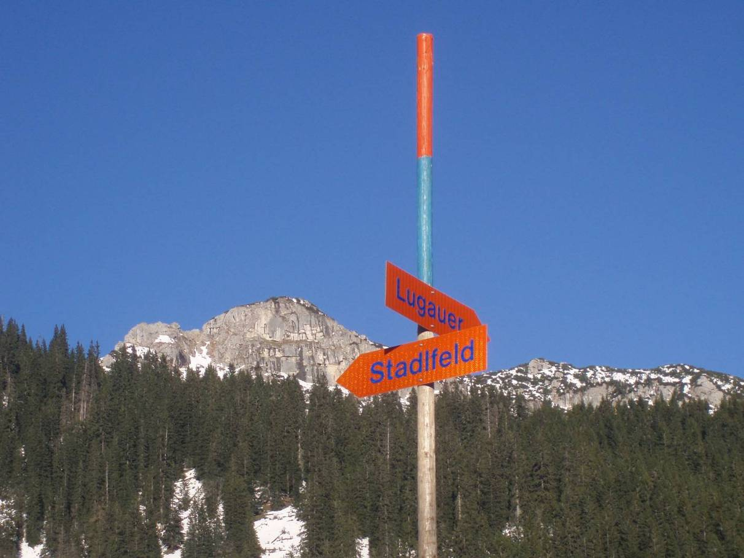
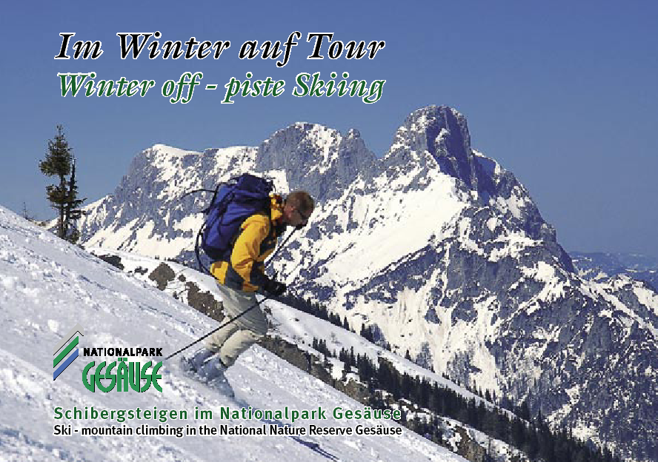
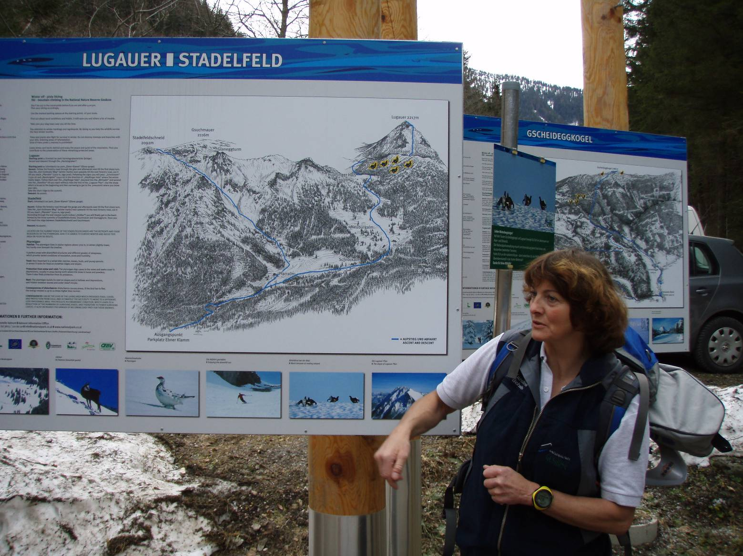

Slide 29
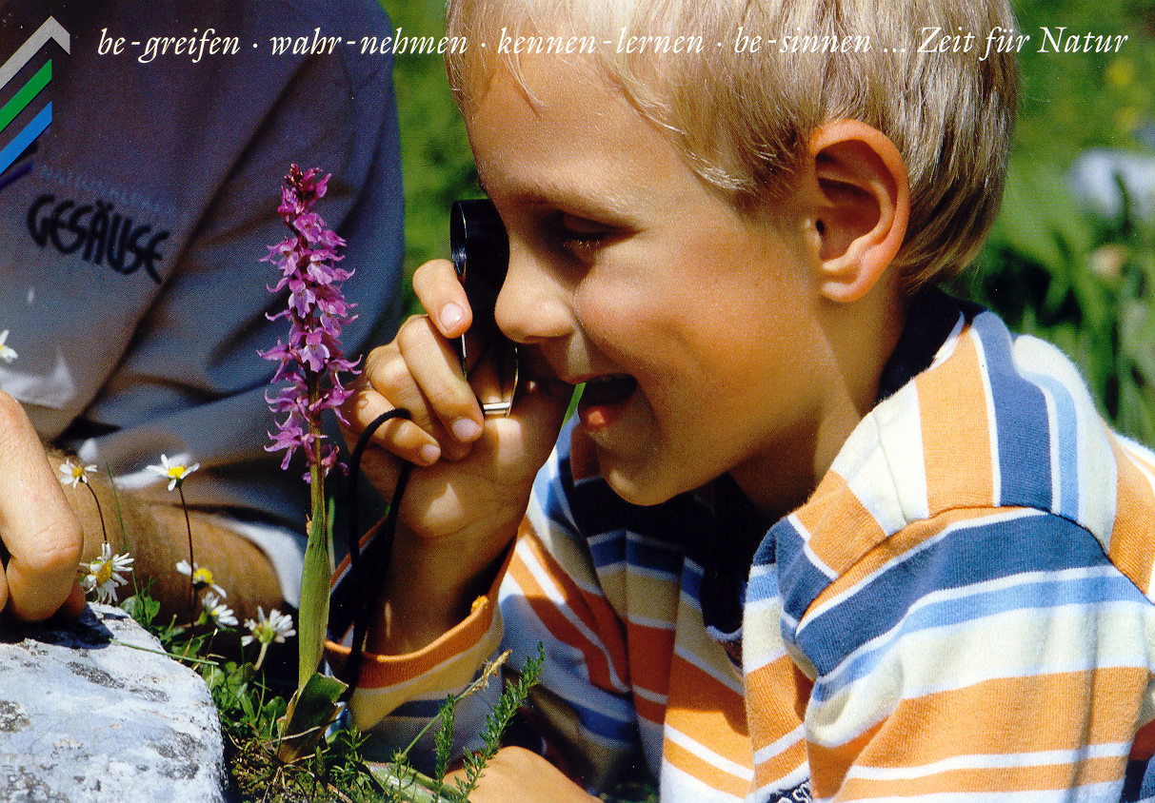
Environmental Education

Slide 30
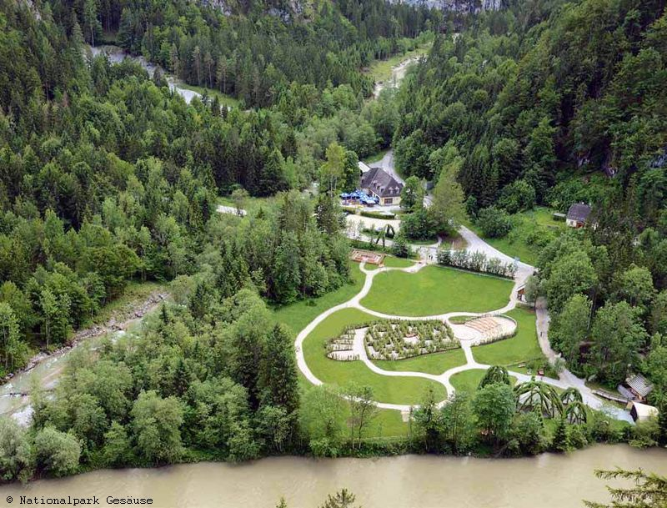
Environmental Education
Educational programme for schools
Summer and winter excursion programme
National Park Gesäuse „Partner Schools“
National Park Gesäuse „Junior Ranger“
Self guided nature trails
Visitor Center „Willow Dome“ and „Ecologigal Footprint“

Slide 31
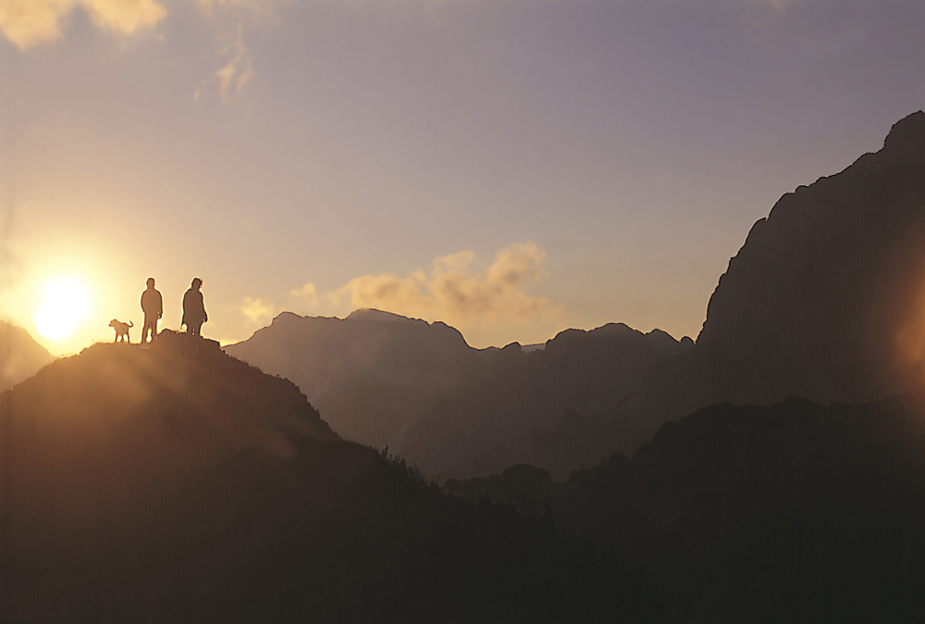
„…to fall in love to nature is one of the greatest adventures of life…“

